Slide 1
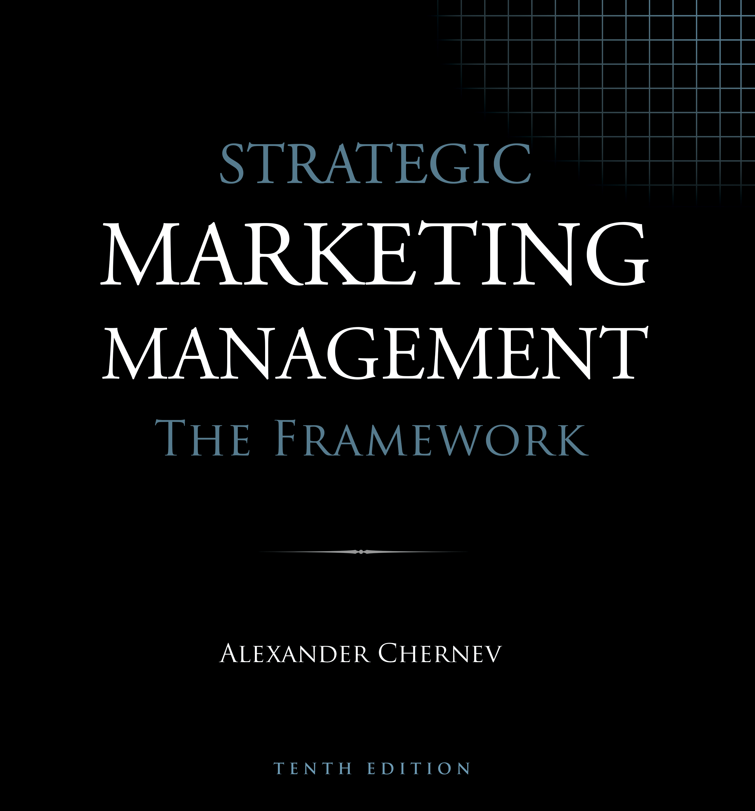

Slide 2
Strategic Marketing Management | The Framework
ISBN: 978-1-936572-59-5
January 2019
Copyright © 2019 by Alexander Chernev
Author website: Chernev.com
Supplemental materials: MarketingToolbox.com
Published by Cerebellum Press | Chicago, IL | USA

Slide 3
The Framework for Marketing Management

Slide 4
Chapter 1
Marketing as a Business Discipline

Slide 5
Figure 1. Making Decisions Using a Framework
Framework
Typical problem
Typical solution
Abstraction
Application
Specific problem
Specific solution
Trial and error

Slide 6
Chapter 2
Marketing Strategy and Tactics

Slide 7
Figure 1. Identifying the Target Market: The 5-C Framework
Company
Collaborators
Customers
Competitors
Context

Slide 8
Figure 2. Defining the Value Exchange
Company
Value
Value
Customers
Value
Collaborators
Value
Value
Value
Competitors
Context

Slide 9
Figure 3. The 3-V Market Value Principle
Company value
The Optimal Value Proposition
Customer value
OVP
Collaborator value

Slide 10
Figure 4. Marketing Tactics: The Seven Attributes Defining the Market Offering
Company value
Customer value
OVP
Collaborator value
Strategy
Tactics
Market Offering
Product
Service
Brand
Price
Incentives
Communication
Distribution

Slide 11
Figure 5. Marketing Tactics as a Process of Designing, Communicating and Delivering Value
Designing value
Product
Service
Brand
Price
Value
Incentives
Communication
Distribution
Communicating value
Delivering value

Slide 12
Figure 6. Marketing Tactics: Company Actions and Customer Impact
Company actions
Customer impact
Designing
value
Attractiveness of the offering
Communicating
value
Awareness of the offering
Delivering
value
Availability of the offering

Slide 13
Figure 7. The Market Value Map
Target Market
Market Offering
Customers
Product
What customer need does the company aim to fulfill? Who are the customers with this need?
What are the key features of the company’s product?
Collaborators
What other entities will work with the company to fulfill the identified customer need?
Service
What are the key features of the company’s service?
Company
What are the company’s resources that will enable it to fulfill the identified customer need?
Brand
Competition
What are the key features of the offering’s brand?
What other offerings aim to fulfill the same need of the same target customers?
Price
Context
What is the offering’s price?
What are the sociocultural, technological, regulatory, economic, and physical aspects of the environment?
Value Proposition
Incentives
Customer Value
What incentives does the offering provide?
What value does the offering create for target customers?
Communication
Collaborator Value
How will target customers and collaborators become aware of the company’s offering?
What value does
the offering create for the company’s collaborators?
Company Value
Distribution
What value does the offering create for the company?
How will the offering be delivered to target customers and collaborators?
Strategy
Tactics

Slide 14
Figure 8. The 4-P Framework
Product
Promotion
Value
Price
Place

Slide 15
Figure 9. The Four Ps and the Marketing Mix
Product
Product
Service
Brand
Incentives
Value
Price
Price
Promotion
Communication
Distribution
Place

Slide 16
Figure 10. The Five Forces of Competition
New entrants
Competitors
Suppliers
Buyers
Substitutes

Slide 17
Chapter 3
The Marketing Plan

Slide 18
Figure 1. The G-STIC Framework for Marketing Management
Goal
Business model
Strategy
Tactics
Implementation
Control

Slide 19
Figure 2. The G-STIC Action-Planning Flowchart
Goal
The ultimate criterion for success
Focus
Benchmarks
Strategy
The value created in the target market
Target market
Value proposition
Tactics
The specifics of the market offering
Product
Service
Brand
Price
Incentives
Communication
Distribution
Implementation
The logistics of creating the offering
Development
Deployment
Control
Monitoring goal progress
Performance
Environment

Slide 20
Figure 3. Market Goals and Objectives
Customer objectives
Collaborator objectives
Company goal
Company objectives
Competitor objectives
Context objectives

Slide 21
Figure 4. The Marketing Plan
Executive Summary
What are the key aspects of the company’s marketing plan?
Situation Overview
Company
Market
What are the company’s history, culture, resources, offerings, and ongoing activities?
What are the key aspects of the markets in which the company competes?
Goal
Focus
Benchmarks
What is the key performance metric the company aims to achieve with the offering?
What are the criteria (temporal and quantitative) for reaching the goal?
Strategy
Target market
Value proposition
Who are the target customers, competitors, and collaborators? What are the company’s resources and context?
What value does the offering create for target customers, collaborators, and company stakeholders?
Tactics
G-STIC Action Plan
Market offering
What are the product, service, brand, price, incentives,
communication, and distribution aspects of the offering?
Implementation
Development
Deployment
How is the company offering being developed?
What processes will be
used to bring the offering to market?
Control
Performance
Environment
How will the company evaluate the progress toward its goal?
How will the company
monitor the environment to identify
new opportunities and threats?
Exhibits
What are the details/evidence supporting the company’s action plan?

Slide 22
Figure 5. The SWOT Framework for Assessing a Company’s Market Position
Favorable factors
Unfavorable factors
Internal factors
Strengths
Weaknesses
Company analysis
External factors
Opportunities
Threats
Market analysis

Slide 23
