Slide 1
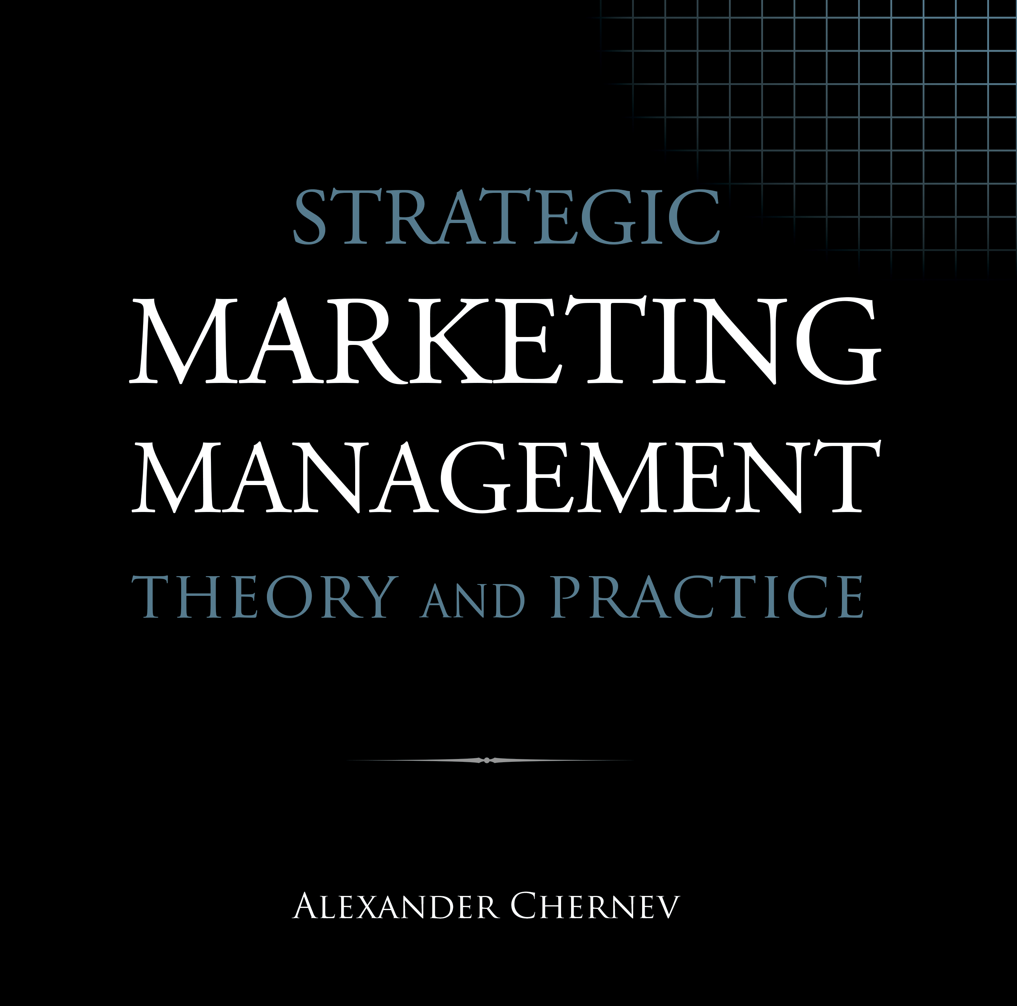

Slide 2
Strategic Marketing Management | Theory and Practice
ISBN: 978-1-936572-58-8
January 2019
Copyright © 2019 by Alexander Chernev
Author website: Chernev.com
Supplemental materials: MarketingToolbox.com
Published by Cerebellum Press | Chicago, IL | USA

Slide 3
Part II: Understanding the Market

Slide 4
Chapter 4
Understanding Consumer Markets

Slide 5
Figure 1. The Customer Journey Map
Evaluate
Active need
Search
Choose
Use
Purchase

Slide 6
Figure 2. Customer Need States
Customer need state
Customer value
Delight
(fully met need)
Experience enhancement
Indifference (largely met need)
Solution to a problem
Problem
(unmet need)

Slide 7
Figure 3. The Dynamics of Customer Needs
Value
Delight
Desired benefits
Consumption
Satisfaction
Need activation
Current benefits
Problem

Slide 8
Figure 4. The Information Processing Funnel
Received information
Selective attention
Selective memory
Selective processing
Processed information

Slide 9
Figure 5. The Value Function
Value
Offering performance

Slide 10
Figure 6. Reference-Point Dependence
Value
Gains
Reference point
Performance
Losses

Slide 11
Figure 7. Loss Aversion
Value
Value of
a gain
Performance
Value
of a loss

Slide 12
Figure 8. Diminishing Marginal Value
Value
Performance

Slide 13
Figure 9. Maslow’s Hierarchy of Needs
Self-fulfillment needs
Self-actualization
Esteem needs
Psychological needs
Belongingness and love needs
Safety needs
Basic needs
Physiological needs

Slide 14
Chapter 5
Gathering Market Insights

Slide 15
Figure 1. The Problem-Driven Market Research Process
Define the business problem
Manager
Formulate the research question
Manager
Research team
Define the research method
Research team
Gather and analyze the data
Research team
Interpret the results
Research team Manager
Solve the business problem
Manager

Slide 16
Figure 2. Key Types of Business Problems
Market analysis
Action planning
Market opportunity
Designing a new offering
Market change
Optimizing an existing offering
Performance gap

Slide 17
Figure 3. Experimentation as a Tool for Gathering Market Insights
Company Actions
Customer Response
Product
Service
Brand
Price
Incentives
Communication
Distribution
Awareness
Beliefs
Preference
Purchase intent Intent to promote
Purchase
Usage
Advocacy
Customer mindset
Offering attributes
Customer behavior
Factors tested
Factors measured

Slide 18
Figure 4. Managing Decision Errors
Reality
True
False
True
Correct
False positive
Data
False negative
Correct
False

Slide 19
Figure 5. Evidence-Based Decision Making
Focus on
creating market
value
Business problem
Research question
Focus on gathering relevant market insights
Data analysis
Data selection
Real world

Slide 20
Figure 6. Making Necessary Tradeoffs
Pros
Option A
Tradeoff
Cons
Decision
Tradeoff
Pros
Option B
Tradeoff
Cons

