Slide 1
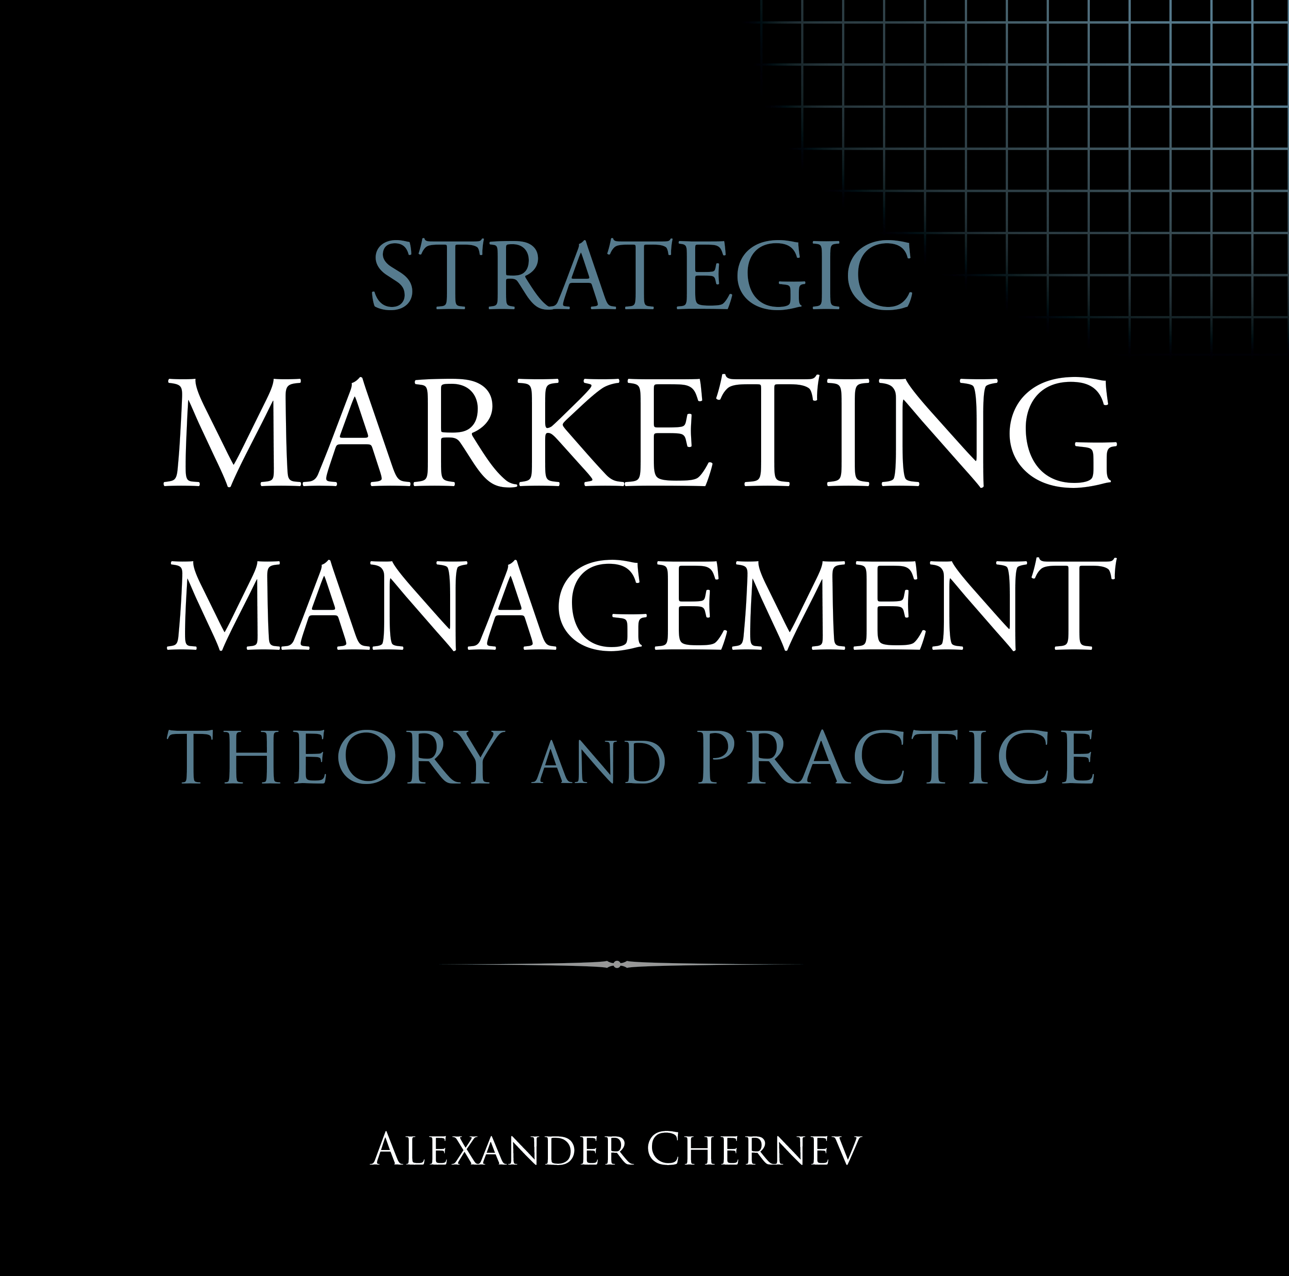

Slide 2
Strategic Marketing Management | Theory and Practice
ISBN: 978-1-936572-58-8
January 2019
Copyright © 2019 by Alexander Chernev
Author website: Chernev.com
Supplemental materials: MarketingToolbox.com
Published by Cerebellum Press | Chicago, IL | USA

Slide 3
Part III: Developing a Marketing Strategy

Slide 4
Chapter 6
Identifying Target Customers

Slide 5
Figure 1. Segment-Based Targeting
Targeting
All potential customers (entire market)
Customers whose needs the company aims to fulfill
(target market)

Slide 6
Figure 2. Strategic Targeting: Key Principles
Target Compatibility
Target Attractiveness
Company resources
Customer needs
Customer resources
Company goals
Customer value
Company value

Slide 7
Figure 3. The Resource Advantage Principle
Unutilized company resources
The company’s ideal customers
Company resources
Competitive wasteland
Unmet customer needs
Competitor resources
Customer needs
Intense competition

Slide 8
Figure 4. Customer Profile and Customer Needs
Need-based targeting
Profile-based targeting
Identifiable customer needs

Slide 9
Figure 5. Linking Customer Value and Profile
Customer value
Needs
Resources
Target
customers
Customer identification
Strategic targeting
Demographics
Customer profile
Psychographics
Geolocation
Behavior
Tactical targeting

Slide 10
Figure 6. Tactical Targeting: Effectiveness
Value-based segment
Profile-based segment
“Sniper” targeting
(optimal)
“Slice-of-the-pie” targeting
(too narrow)
“Shot-in-the-dark” targeting
(off base)

Slide 11
Figure 7. Tactical Targeting: Cost-Efficiency
Value-based segment
Profile-based segment
“Sniper” targeting
(optimal)
“Shotgun” targeting
(too broad)

Slide 12
Figure 8. Targeting Multiple Segments
Offering B
Offering A

Slide 13
Figure 9. Market Segmentation and Targeting
Defining market
segments
Identifying target customers
All potential customers (entire market)
Customers with similar needs
(segmented market)
Customers whose needs the company aims to fulfill
(target market)

Slide 14
Figure 10. Segmentation, Mass Marketing, & One-to-One Marketing
Customer 1
Customer 1
Offering A
Customer 1
Customer 2
Offering A
Customer 2
Offering B
Customer 2
Offering
Customer 3
Customer 3
Offering C
Customer 3
Customer 4
Customer 4
Offering D
Customer 4
Customer 5
Offering B
Customer 5
Offering E
Customer 5
Customer 6
Customer 6
Offering F
Customer 6
Mass marketing
Segment-based marketing
One-to-one marketing

Slide 15
Figure 11. Strategic and Tactical Segmentation Facilitates the Process of Identifying Target Customers
Strategic segmentation
(value-based)
Tactical segmentation
(profile-based)
All potential customers (entire market)
Strategic targeting
(value-based)
Channel A
Channel C
Channel B
Tactical targeting
(profile-based)

Slide 16
Figure 12. Common Segmentation Errors
A. Irrelevant
B. Heterogeneous
C. Not exhaustive

Slide 17
Figure 13. The Long Tail
Popularity
Mass market
The long tail
Offerings

Slide 18
Chapter 7
Developing a Customer Value Proposition

Slide 19
Figure 1. Value as a Function of Customer Needs and Offering Attributes
Customer needs
Customer value
Company offering

Slide 20
Figure 2. Dimensions of Customer Value
Functional
value
Customer value
Psychological
value
Monetary value

Slide 21
Figure 3. The Customer Value Proposition
Company offering
Reason to choose
Alternative options
Value
Value
Customer needs

Slide 22
Figure 4. Competitive Value Map
Customer value
Competitive parity
Company offering
Competitive advantage
Competitive disadvantage
Competitive offering
Attribute importance
Attribute 1
Attribute 2
Attribute 3
Attribute 4
Attribute 5

Slide 23
Figure 5. Customer Value Proposition and Positioning
Positioning
Primary
benefit(s)
Value proposition
Secondary
benefit(s)
Trivial
benefits
Costs

Slide 24
Figure 6. Single-Benefit Positioning
Primary benefit
Benefit 1
Key reason for choice
Benefit 2
Secondary benefits
Benefit 3
Benefit 4
Benefit 5

Slide 25
Figure 7. Multi-Benefit Positioning
Primary benefits
Benefit 1
Key reason for choice
Benefit 2
Benefit 3
Secondary benefits
Benefit 4
Benefit 5

Slide 26
Figure 8. Holistic Positioning
Benefit 1
Benefit 2
Benefit 3
Overall
benefit
Key reason for choice
Benefit 4
Benefit 5

Slide 27
Figure 9. Positioning Strategies Based on their Ability to Create a Sustainable Competitive Advantage
Psychological benefits
Positioning
Functional benefits
Sustainable competitive advantage
Monetary benefits

Slide 28
Figure 10. Positioning Map
Attribute 1
Offering A
Offering B
Offering C
Attribute 2
Offering E
Offering D

Slide 29
Figure 11. Blue Ocean Strategy
Red Ocean Strategy
Blue Ocean Strategy
Compete in existing markets
Create uncontested markets
Fulfill existing demand
Create new demand
Beat the competition
Make the competition irrelevant
Improve the value-cost tradeoff
Redefine the value-cost tradeoff
Focus on differentiation or low cost
Achieve differentiation at low cost

Slide 30
Chapter 8
Creating Company Value

Slide 31
Figure 1. Dimensions of Company Value
Monetary
value
Company
value
Strategic value

Slide 32
Figure 2. The Key Profit Drivers
Sales volume
Revenues
Unit price
Profit
Variable costs
Costs
Fixed costs

Slide 33
Figure 3. Strategies for Growing Sales Volume
New to the category
Market-growth strategy
New customers
Competitors’ customers
Steal-share strategy
Sales volume
Current customers
Market-penetration strategy

Slide 34
Figure 4. Managing Profits by Lowering Costs
COGS
R&D costs
Costs
Marketing costs
Other costs

Slide 35
Figure 5. The Profit Impact of Strategic Offerings
Company value
Profit
Profit
Offering A
Offering B
Offering C
Strategic value
Strategic value

Slide 36
Figure 6. Economic Value Analysis
Monetary
value
Company
value
Monetizing strategic value
Strategic value

Slide 37
Figure 7. Analyzing the Total Cost of a Company’s Offering in a Competitive Context
Durability
Reliability
Warranty
Service
Difference in strategic value
Durability
Reliability
Warranty
Service
Strategic value
Price
Price
Purchase price
Difference in monetary value
Company offering
Competitive offering

Slide 38
Figure 8. Creating Market Value through Collaboration
B2B
B2C
Company
Value
Collaborator
Value
Customer
Value

Slide 39
Figure 10. Calculating Trade Margins
Manufacturer cost: $3
Selling price to the wholesaler: $10
Margin: $7
Margin (% of selling price): $7/$10 = 70%
Manufacturer
Purchase price from the manufacturer: $10
Selling price to the retailer: $15
Margin: $5
Margin (% of selling price): $5/$15 = 33%
Wholesaler
Purchase price from the wholesaler: $15
Selling price to the customer: $20
Margin: $5
Margin (% of selling price): $5/$20 = 25%
Retailer
Customer
Purchase price: $20

Slide 40
Figure 11. Break-Even of a Fixed Cost Investment
Costs
Revenues
Revenues
Break-even point
Profit
Total costs
Loss
Fixed costs
Volume

