Slide 1
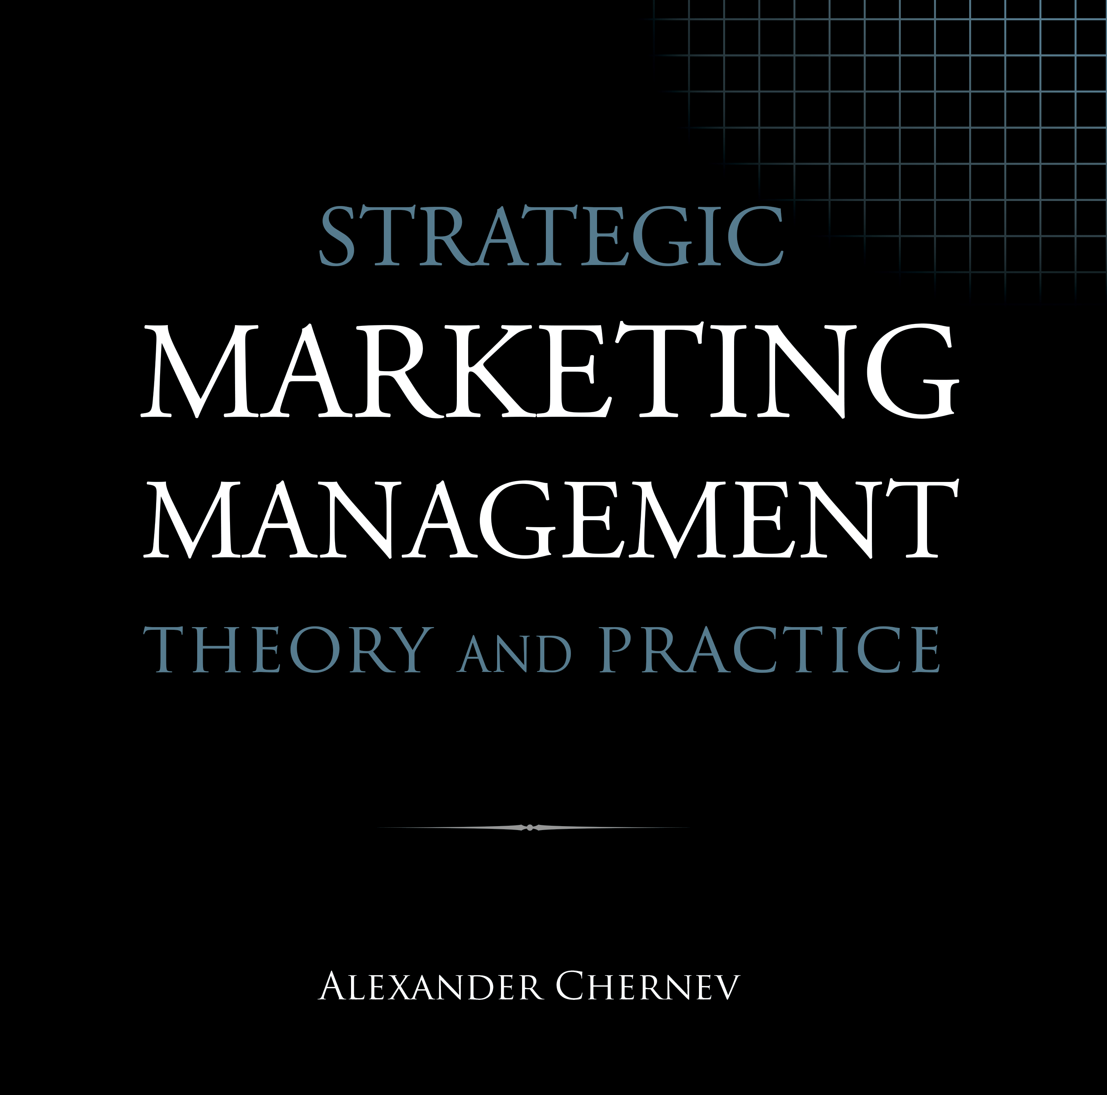

Slide 2
Strategic Marketing Management | Theory and Practice
ISBN: 978-1-936572-58-8
January 2019
Copyright © 2019 by Alexander Chernev
Author website: Chernev.com
Supplemental materials: MarketingToolbox.com
Published by Cerebellum Press | Chicago, IL | USA

Slide 3
Part IV: Designing the Offering

Slide 4
Chapter 9
Managing Products

Slide 5
Figure 1. Product Management as a Value-Creation Process
Company value
Customer value
OVP
Collaborator value
Market Offering
Product
Service
Brand
Price
Incentives
Communication
Distribution

Slide 6
Figure 2. Product Attributes and Customer Benefits
Attribute A
Benefit A
Functional benefits
Attribute B
Benefit B
Attribute C
Product
Benefit C
Psychological benefits
Attribute D
Benefit D
Attribute E
Benefit E
Monetary benefits
Attribute F
Benefit F
Product attributes
Customer needs

Slide 7
Figure 3. Product Portfolio and Product Lines
Product portfolio
Product line X
Product line Y
Product A
Product B
Product C
Product D
Product E

Slide 8
Figure 4. Product Platforms and Product Lines
Product
line
Customer benefits
Product A
Product B
Product C
Product D
Product platform X
Product platform Y
Company processes

Slide 9
Figure 5. Network Product Platforms
Company product line
Product A
Product B
Product C
Product D
Product platform X
Product platform Y
Product E
Product F
Product G
Product H
Competitor product line

Slide 10
Figure 6. Managing the Product Lifecycle
Financial performance
Revenues
Profits
Introduction
Growth
Maturity
Decline
Time

Slide 11
Figure 7. Extending Product Lifestyle through Innovation
Sales
Third
generation
Second
generation
First
generation
Time

Slide 12
Figure 8. Benefit Visibility in Product Design
Search attributes
Customer value
Experience attributes
Observability of benefits
Credence attributes

Slide 13
Chapter 10
Managing Services

Slide 14
Figure 1. Service Management as a Value-Creation Process
Company value
Customer value
OVP
Collaborator value
Market Offering
Product
Service
Brand
Price
Incentives
Communication
Distribution

Slide 15
Figure 2. Creating Market Value Through Superior Customer Service
Employee selection, training and motivation
Employee competence and satisfaction
Superior service delivery
Company
profits
Customer loyalty
Customer value

Slide 16
Figure 3. Managing Employee Performance
Train
Inform
Recruit
Service delivery
Motivate
Control
Empower
Company culture

Slide 17
Figure 4. Building a Service-Oriented Company Culture
Management beliefs
Company policies
Employee selection
Norms of behavior
Teamwork
Service quality

Slide 18
Figure 5. Customer Reaction to Service Failures
Delight
Stay loyal and endorse
Resolve
Satisfaction
Stay loyal
Service failure
Acquiescence
Stay less loyal
Ignore
Dissatisfaction
Stay disloyal or leave quietly
Anger
Stay and disparage or
leave and disparage
Company action
Customer experience
Customer behavior

Slide 19
Figure 6. The Gap Model of Service Quality
Management beliefs
Gap 1
Gap 2
Service design
Gap 3
Service delivery
Communication
Company
Gap 4
Customer
Perceived service
Gap 5
Expected service
Word of mouth
Needs
Experience

Slide 20
Chapter 11
Managing Brands

Slide 21
Figure 1. Branding as a Value-Creation Process
Company value
Customer value
OVP
Collaborator value
Market Offering
Product
Service
Brand
Price
Incentives
Communication
Distribution

Slide 22
Figure 2. Brand Association Maps of Starbucks and Apple
Creative
Different
Energy
Friendly
Easy to learn
Innovative
Sleek design
Coffee
Self-identity
Fast
My drink
Easy to use
Stylish
Great service
Morning
Mac
Apple
iTunes
Great
taste
Starbucks
My ritual
iPhone
Entertainment
Nearby
My place
iPod
Consistent
experience
Microsoft
iPad
Indulgence
Music on the go
Home
Connectivity
Tablet
Convenient
Workplace

Slide 23
Figure 3. Key Brand Identifiers
Logo
Motto
Character
Brand name
Soundmark
Packaging
Product design

Slide 24
Figure 5. Single-Brand, Cobranding, and Multi-Brand Portfolio Strategies
Single parent brand
New sub-brand
Endorsed new brand
Independent new brand
Single-brand strategy
Multi-brand strategy
Cobranding

Slide 25
Figure 6. Vertical Brand Extensions
Price
Price tier A
Upscale
extension
Price tier B
Core
offering
Price tier C
Downscale
extension
Benefits

Slide 26
Figure 7. Horizontal Brand Extensions
Price
Extension A
Core
offering
Extension B
Benefits
Category A
Category B
Category C

Slide 27
Figure 8. Brand Power, and Brand Equity
Branding activities
Brand
image
Customer value
Customer behavior
Company value
Brand power
Brand equity

Slide 28
Chapter 12
Managing Price

Slide 29
Figure 1. Pricing as a Value-Creation Process
Company value
Customer value
OVP
Collaborator value
Market Offering
Product
Service
Brand
Price
Incentives
Communication
Distribution

Slide 30
Figure 2. The Price Elasticity of Demand
Price
$15
$10
Inelastic demand
Elastic demand
20
25
50
Quantity

Slide 31
Figure 3. Price Segmentation as a Targeting Tool
Price for Segment A
Price for Segment B
Price for Segment C

Slide 32
Figure 4. The Relationship Between Variable and Fixed Costs
Costs
Total costs
Fixed costs
Variable costs
Volume

Slide 33
Figure 5. Penetration, Skim, and Loss-Leader Pricing
Range of
profitable prices
Skim
pricing
Customer willingness to pay
Penetration pricing
Range of unprofitable prices
Loss-leader pricing

Slide 34
Figure 6. Competitive Price–Benefit Map
Price
Value-equivalence line
Offering A
Offering B
Offering D
Offering E
Offering C
Benefits

Slide 35
Chapter 13
Managing Incentives

Slide 36
Figure 1. Managing Incentives as a Value-Creation Process
Company value
Customer value
OVP
Collaborator value
Market Offering
Product
Service
Brand
Price
Incentives
Communication
Distribution

Slide 37
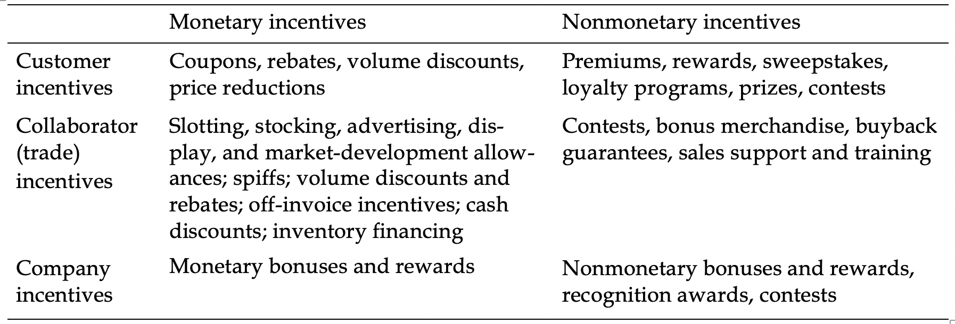
Figure 2. Incentive Types

Slide 38
Figure 3. Push and Pull Promotions
Manufacturer
Manufacturer
Demand
Communication
Incentives
Demand
Retailer
Retailer
Demand
Communication
Incentives
Demand
Communication
Incentives
Customers
Customers
Push promotions
Pull promotions

Slide 39
Figure 4. The Prisoner’s Dilemma
Prisoner B
Prisoner A
Confess
Not confess
Confess
-5 / -5
-1 / -10
Not confess
-10 / -1
-3 / -3

Slide 40
Figure 5. The Prisoner’s Dilemma in Sales Promotion
Company B
Company A
Discount
Not discount
Discount
$10M / $10M
$20M / $5M
Not discount
$5M / $20M
$15M / $15M

