Slide 1
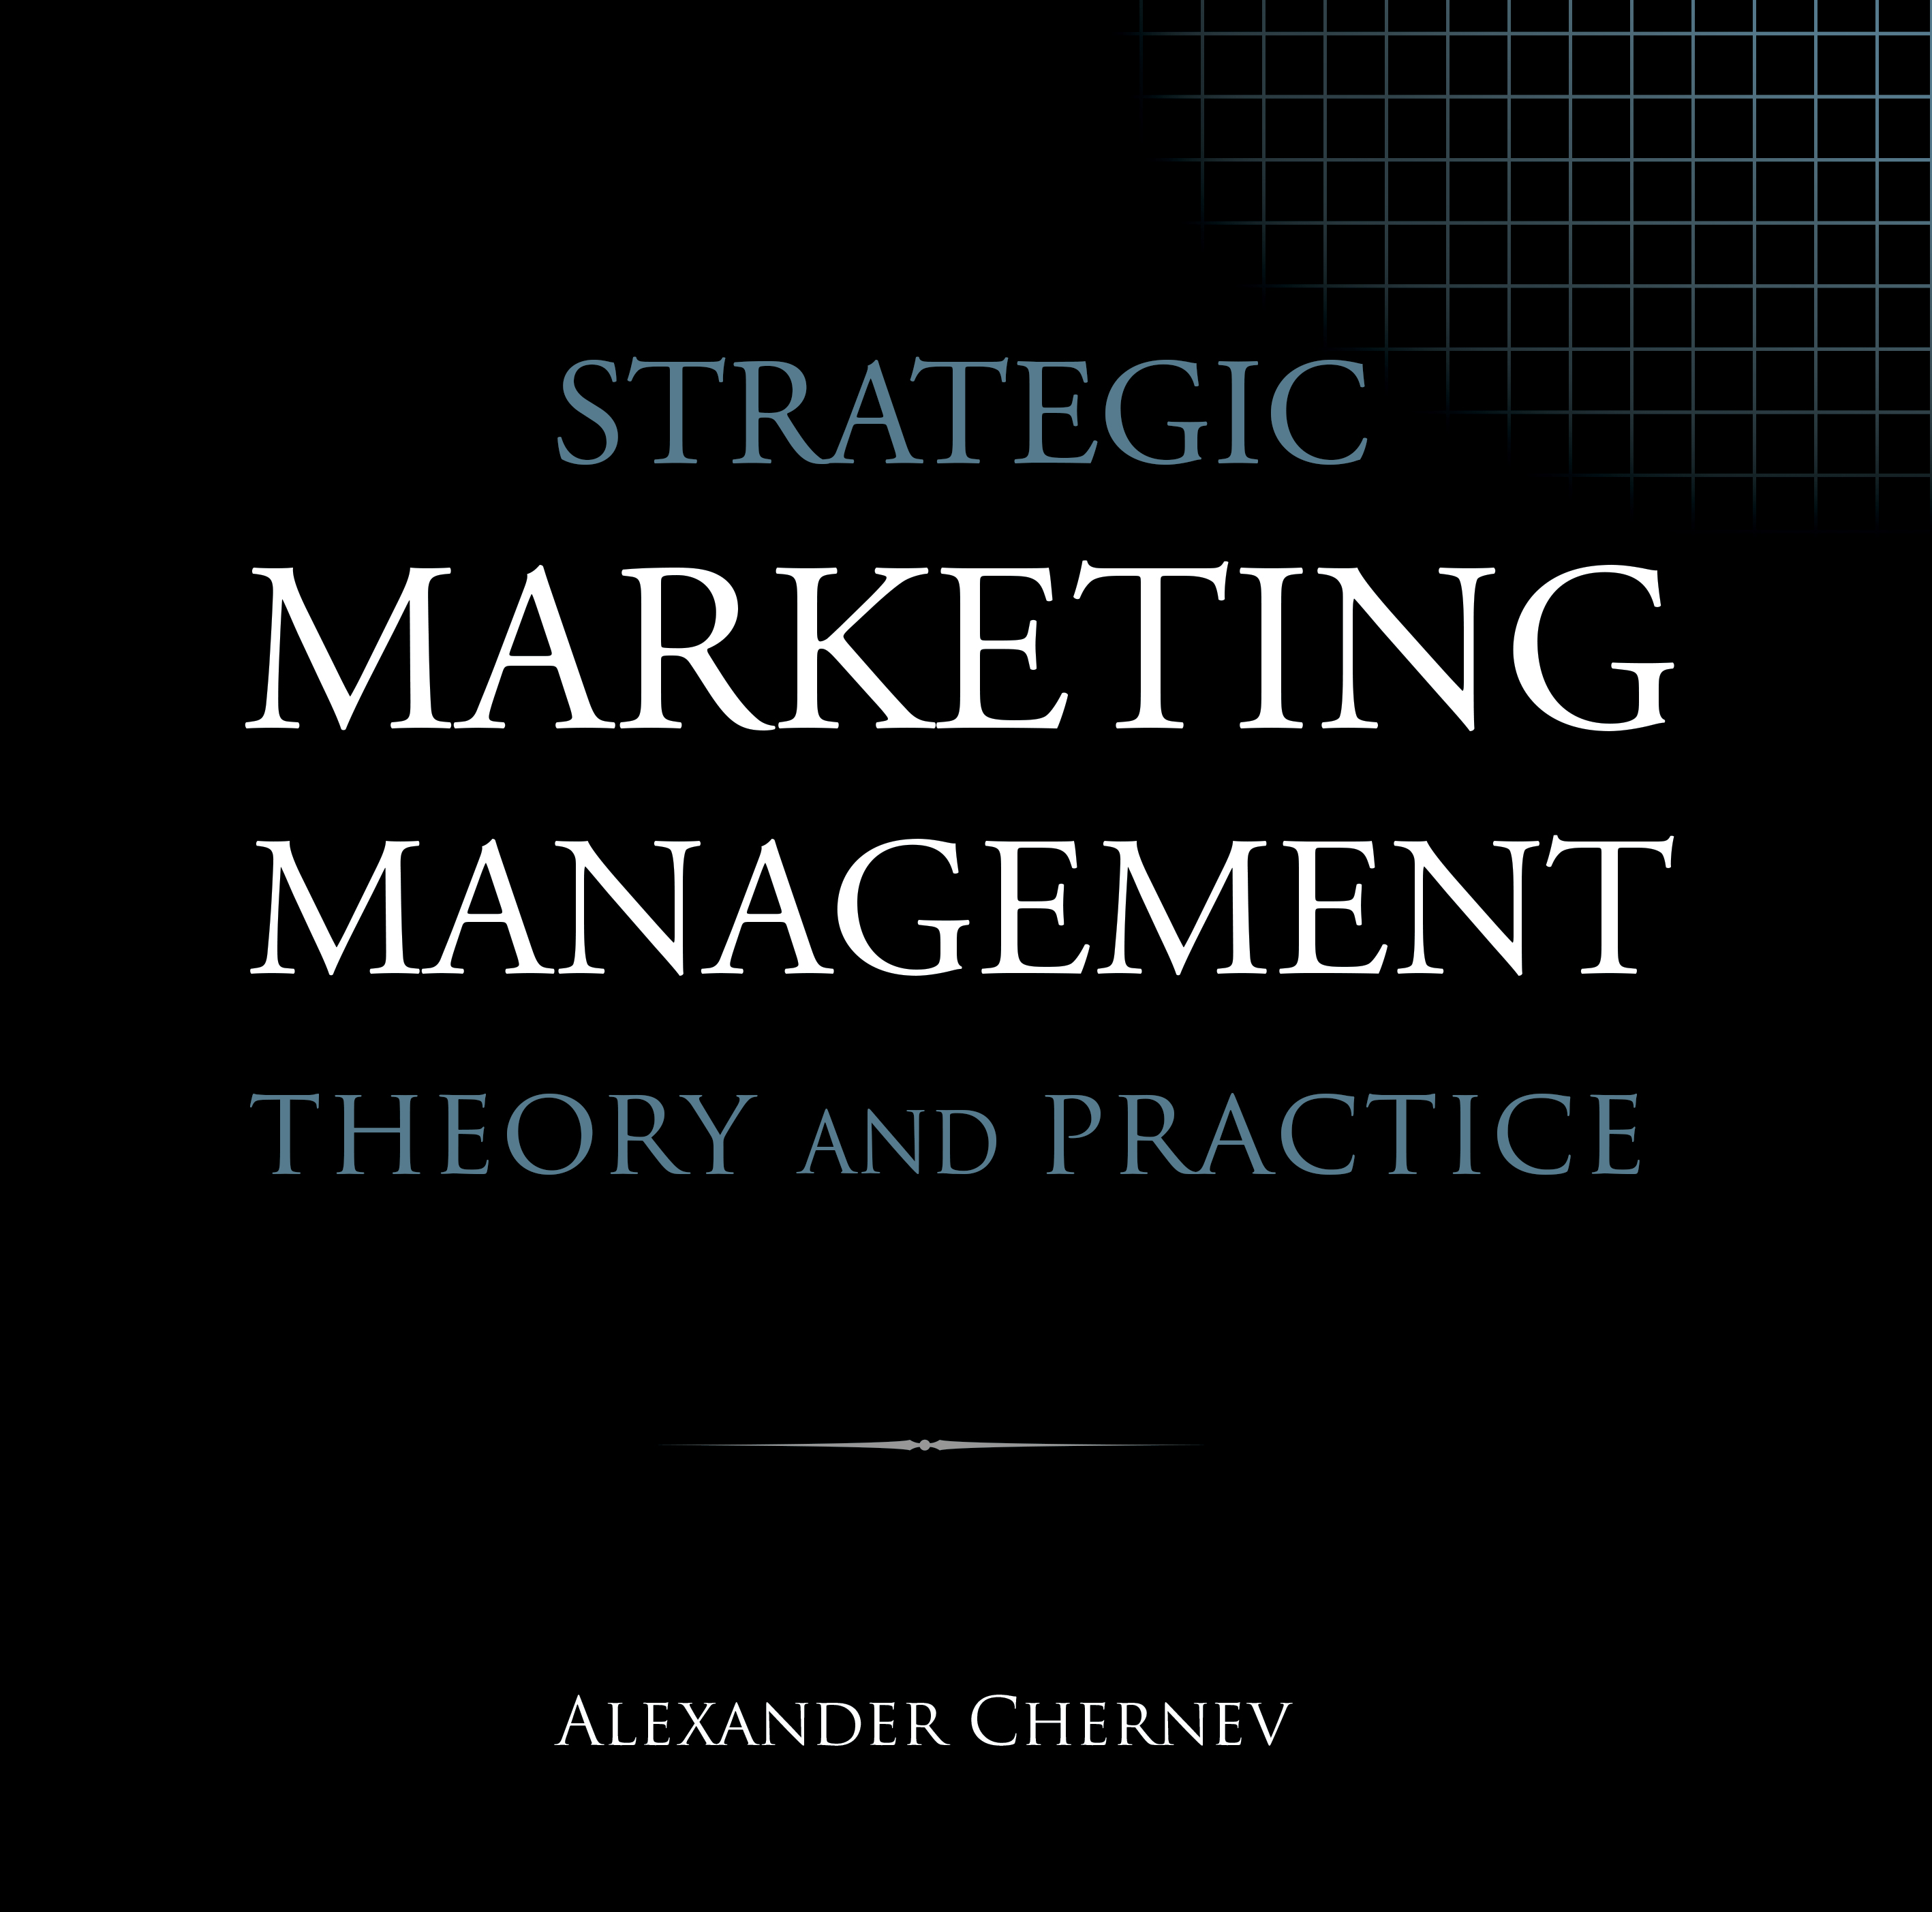

Slide 2
Strategic Marketing Management | Theory and Practice
ISBN: 978-1-936572-58-8
January 2019
Copyright © 2019 by Alexander Chernev
Author website: Chernev.com
Supplemental materials: MarketingToolbox.com
Published by Cerebellum Press | Chicago, IL | USA

Slide 3
Part V: Communicating and Delivering the Offering

Slide 4
Chapter 14
Managing Communication

Slide 5
Figure 1. Communication as a Value-Creation Process
Company value
Customer value
OVP
Collaborator value
Market Offering
Product
Service
Brand
Price
Incentives
Communication
Distribution

Slide 6
Figure 2. The G-STIC Framework for Managing Communication
Marketing Strategy
Marketing plan
Target market
Value proposition
Goal
Focus
Benchmarks
Strategy
Audience
Message
Tactics
Communication campaign
Media
Creative
Implementation
Development
Deployment
Control
Performance
Environment

Slide 7
Figure 3. Communication Goals as a Function of the Customer Decision Journey
Generate interest
Evaluate
Build preferences
Activate the need
Create awareness
Active need
Discover
Choose
Encourage repurchase
Nudge to buy
Use
Purchase
Foster usage

Slide 8
Figure 4. Programmatic Media Buying
Advertiser
Demand-side platform
Advertising exchange
Supply-side platform
Publisher

Slide 9
Figure 5. The Communication Plan
Executive Summary
What are the key aspects of the company’s communication campaign?
Marketing Strategy
Market
Value
What are the key aspects of the target market in which the company aims to compete?
What is the value proposition of the
company’s offering?
Goal
Focus
Benchmarks
What is the focus of the
company’s communication?
What are the temporal and quantitative benchmarks for reaching the goal?
Strategy
Audience
Message
Who is the company’s
target audience?
What is the message the company aims to communicate?
Tactics
Media
Creative
G-STIC Action Plan
How will the company’s message be expressed?
Where will the audience encounter the company’s communication?
Implementation
Development
Deployment
What resources need to be developed/acquired to communicate the company’s message?
What is the process of bringing the company’s message to the target audience?
Control
Performance
Environment
How will the company evaluate the effectiveness of the communication campaign?
How will the company monitor the environment to identify emerging opportunities and threats?
Exhibits
What are the details/evidence supporting the company’s communication plan?

Slide 10
Chapter 15
Personal Selling

Slide 11
Figure 1. Sales Productivity as a Function of Sales Force Size
Salesforce productivity
Breakeven point
Salesforce costs
Optimal size
Salesforce revenues
Salesforce size

Slide 12
Figure 2. Managing Sales Force Performance
Train
Support
Recruit
Salesforce
Motivate
Control
Empower
Company culture
Notes:
Customers: HDI; Collaborators: HDI; Competitors: AT&T vs. Version, politics; Context: economy, technology, regulatory (monopoly)

Slide 13
Figure 3. Decision-Making Unit: Key Roles
Decision-Making Unit
Decider
Initiator
Personal selling
Purchaser
Gatekeeper
User
Influencer

Slide 14
Figure 4. The Customer Decision Journey
Search
Evaluate
Active need
Define
Choose
Use
Purchase

Slide 15
Figure 5. The Personal Selling Process
Prospecting
Customizing
Presenting
Negotiating
Closing
Servicing

Slide 16
Figure 6. The SPIN Model of Selling
Situation questions
Establish the context
Problem questions
Reveal implied needs
SPIN questions
Define the problem faced by the buyer
Implication questions
Need-payoff questions
Underscore the importance of solving the problem
Articulate the benefits of the proposed solution
Benefits of the offering

Slide 17
Chapter 16
Managing Distribution

Slide 18
Figure 1. Distribution as a Value-Creation Process
Company value
Customer value
OVP
Collaborator value
Market Offering
Product
Service
Brand
Price
Incentives
Communication
Distribution

Slide 19
Figure 2. Distribution Channel Structure
Company
Wholesaler
Retailer
Retailer
Customers
Customers
Customers
Direct channel
Indirect channels
Hybrid channel

Slide 20
Chapter 17
Retail Management

Slide 21
Figure 1. Key Trends in Retail Management
Consolidation
Speed
Retailer power
Convenience
Private labels
Retailing
Mobile shopping
Omnichannel
Customer insight
New retail formats
Improved logistics

Slide 22
Figure 2. Retailing as a Value-Creation Process
Retailer value
Customer value
OVP
Collaborator value
Market Offering
Product
Service
Brand
Price
Incentives
Communication
Distribution

Slide 23
Figure 3. Price Image Drivers and Market Outcomes
Average price level
Known value items
Price evaluation
Price range
Price fairness
Sales promotions
Price image
Store choice
Communication
Choice deferral
Physical attributes
Purchase quantity
Service level
Product choice
Retailer policies
Price image drivers
Market outcomes

