Slide 1
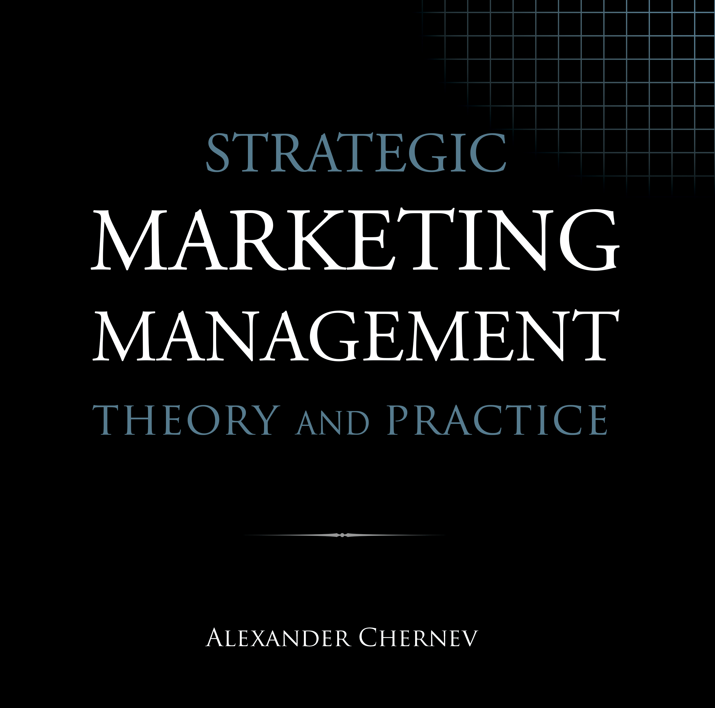

Slide 2
Strategic Marketing Management | Theory and Practice
ISBN: 978-1-936572-58-8
January 2019
Copyright © 2019 by Alexander Chernev
Author website: Chernev.com
Supplemental materials: MarketingToolbox.com
Published by Cerebellum Press | Chicago, IL | USA

Slide 3
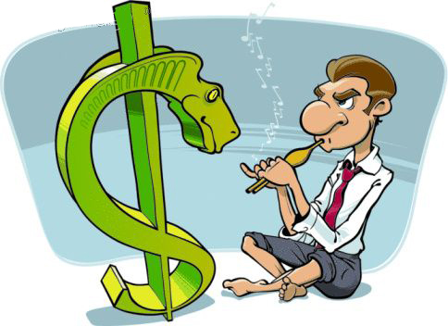
Part VI: Managing Growth

Slide 4
Chapter 18
Gaining and Defending Market Position

Slide 5
Figure 1. Steal-Share Strategy
Current users
New users

Slide 6
Figure 2. Market-Growth Strategy
Current users
New users

Slide 7
Figure 3. Market-Growth Strategy for a Superior Offering
Current users
New users

Slide 8
Figure 4. Market-Penetration Strategy
Current users
New users

Slide 9
Figure 5. Market-Creation Strategy
New
market
Current market

Slide 10
Figure 6. Defensive Marketing Strategies
Price
Launch premium offering
Move upscale
Stay the course
Increase benefits
Move downscale
Launch value offering
Reduce price
Benefits
Source: Stephen Hoch (1996), “How Should National Brands Think about Private Labels?” Sloan Management Review, 37 (2), 89–102

Slide 11
Figure 7. The Adoption Funnel
Awareness
Attractiveness
Affordability
Availability
Purchase

Slide 12
Figure 8. Identifying Adoption Gaps
Awareness gap
Attractiveness gap
Affordability gap
Availability gap
Purchase gap
All target customers
Aware of the offering’s existence
Perceive the offering to be attractive
Perceive the offering to be affordable
Have access to the offering
Purchase the offering

Slide 13
Figure 9. The Usage Funnel
Satisfaction
Usage frequency
Usage quantity
Repurchase

Slide 14
Figure 10. Identifying Usage Gaps
Satisfaction gap
Usage-frequency gap
Usage-quantity gap
Repurchase
gap
Purchased the offering
Satisfied with the offering
Use the offering frequently
Use large quantity per occasion
Repurchase the offering

Slide 15
Figure 11. Vertical Product-Line Extensions
Price
Upscale
offering
Core
offering
Downscale
offering
Benefits

Slide 16
Figure 12. Horizontal Product-Line Extensions
Price
Offering A
Core
offering
Offering B
Benefits

Slide 17
Figure 13. Product-Line Cannibalization
Current offering
Current offering
Current offering
Cannibalized sales
New offering
Competitive offerings
Competitive offerings
Competitive offerings
New offering
A. Single offering
B. Two offerings without cannibalization
C. Two offerings with cannibalization

Slide 18
Figure 14. The Fighting-Brand Strategy
Price
Quality
Incumbent brand
Low-price competitors
Fighting brand
Time

Slide 19
Figure 15. The Sandwich Strategy
Price
Quality
Premium brand
Incumbent brand
Low-price competitors
Fighting brand
Time

Slide 20
Figure 16. The Good-Better-Best Strategy
Price
Quality
Best
Incumbent brand
Better
Low-price competitors
Good
Time

Slide 21
Figure 17. The Product-Market Growth Framework
Current customers
New customers
Current products
Market penetration
Market development
New products
Product development
Diversification

Slide 22
Figure 18. Break-Even Rate of Cannibalization
Sales volume of the incumbent offering unaffected by the new offering
Sales volume of the incumbent offering cannibalized by the new offering
Competitive offerings
Sales volume of the new offering gained from the competitive offerings

Slide 23
Chapter 19
Managing New Products

Slide 24
Figure 1. The Stage-Gate Framework for Developing New Offerings
Stage 1
Stage 2
Stage 3
Stage 4
Stage 5
Idea
generation
Concept development
Business model design
Offering development
Commercial deployment
Gate 1 Idea validation
Gate 2
Concept validation
Gate 3
Business model validation
Gate 4
Offering validation

Slide 25
Figure 2. Top-Down (Market-Driven) Idea Generation
Market opportunity
Problem in search of an invention
Top-down
idea discovery
Invention

Slide 26
Figure 3. Bottom-Up (Invention-Driven) Idea Generation
Market opportunity
Invention in search of a problem
Bottom-up
idea discovery
Invention

Slide 27
Figure 4. Concept Storyboard
1
2
3
4
Customer Problem
Alternative Options
Company Offering
Customer Value
What customer problem does the company aim to solve?
What are the alternative means to solve this problem?
What are the key aspects of the company’s offering?
How does the offering solve customers’ problem better than the alternative options?

Slide 28
Figure 5. The Validated-Learning Approach
Observe the market
Generate an idea
Build a prototype
Test the prototype
Build the offering
Learn from the outcome

Slide 29
Figure 6. The Key Components of a Business Model of a New Offering
Target market
Market offering
Customers
Product
Collaborators
Service
Company
Competitors
Brand
Context
Price
Value proposition
Incentives
Customer Value
Communication
Collaborator Value
Company Value
Distribution

Slide 30
Figure 7. The Path of Least Resistance
Customers with an unmet need (all target customers)
Customers who recognize the unmet need as a problem that needs solving
Path of least resistance
Customers who actively seek a solution to the problem

Slide 31
Figure 7. The Path of Least Resistance
Customers with an unmet need (all target customers)
Customers who can be informed about the offering in a cost-efficient manner
Path of least resources
Customers to whom the offering can be delivered in a cost-efficient manner

Slide 32
Figure 9. The S-Curve of the Total Number of Adoptions of an Innovation
Total adoptions
Speed of diffusion
Inflection point
Market potential
Time

Slide 33
Figure 10. The Bell-Shaped Curve of the New Adoptions of an Innovation
Individual adoptions
Peak of
adoptions
Time

Slide 34
Figure 11. Alternative Patterns of Adoption of Innovation
Individual adoptions
Individual adoptions
Time
Time

Slide 35
Figure 12. Rogers’ Categorization of Customer Based on the Time of Adoption of Innovation
Number of adoptions
Innovators
Early adopters
Early majority
Late majority
Laggards
Time

Slide 36
Figure 13. Moore’s Application of the Rogers Model to Technology Markets
Number of adoptions
The chasm
Early market
Mainstream market
Enthusiasts
Visionaries
Pragmatists
Conservatives
Skeptics
Time

Slide 37
Figure 14. The Minimum Viable Offering as a Function of Offering’s Desirability, Feasibility, and Viability
Customer value
Technological complexity
Company costs
MVO
Offering functionality
MVO
Offering functionality
MVO
Offering functionality
Offering desirability
(Diminishing marginal value)
Offering feasibility
(Increasing marginal complexity)
Offering viability
(Increasing marginal costs)

Slide 38
Chapter 20
Customer Relationship Management

Slide 39
Figure 1. Promotion-Driven Customer Acquisition
Targeting
Acquisition
Retention
Identify buyers likely to purchase the company’s offering
Develop customer acquisition strategy
Develop customer retention
strategy

Slide 40
Figure 2. Loyalty-Driven Customer Acquisition
Value
Retention
Targeting
Acquisition
Identify drivers of long-term customer value
Develop customer retention
strategy
Identify customers with high lifetime value potential
Develop customer acquisition
strategy

Slide 41
Figure 3. The Customer Equity Framework
Sales revenues
Operational costs
Marketing costs
Customer equity
Monetary value
Customer advocacy
Customer insight
Strategic value
Notes:
Customers: HDI; Collaborators: HDI; Competitors: AT&T vs. Version, politics; Context: economy, technology, regulatory (monopoly)

Slide 42
Figure 4. Aligning Customer Equity and Consumer Value
Customer equity
Vulnerable customers
High-value customers
High
Low
Wasted effort
Free
riders
Low
High
Value received by customers

Slide 43
Figure 5. Key Customer Management Metrics
3
1
Awareness rate
2
Conversion rate
5
3
Penetration rate
1
2
4
4
Retention rate
5
Attrition rate
All target customers
Aware of
the offering
Purchased the offering
Repurchased the offering

