Slide 1
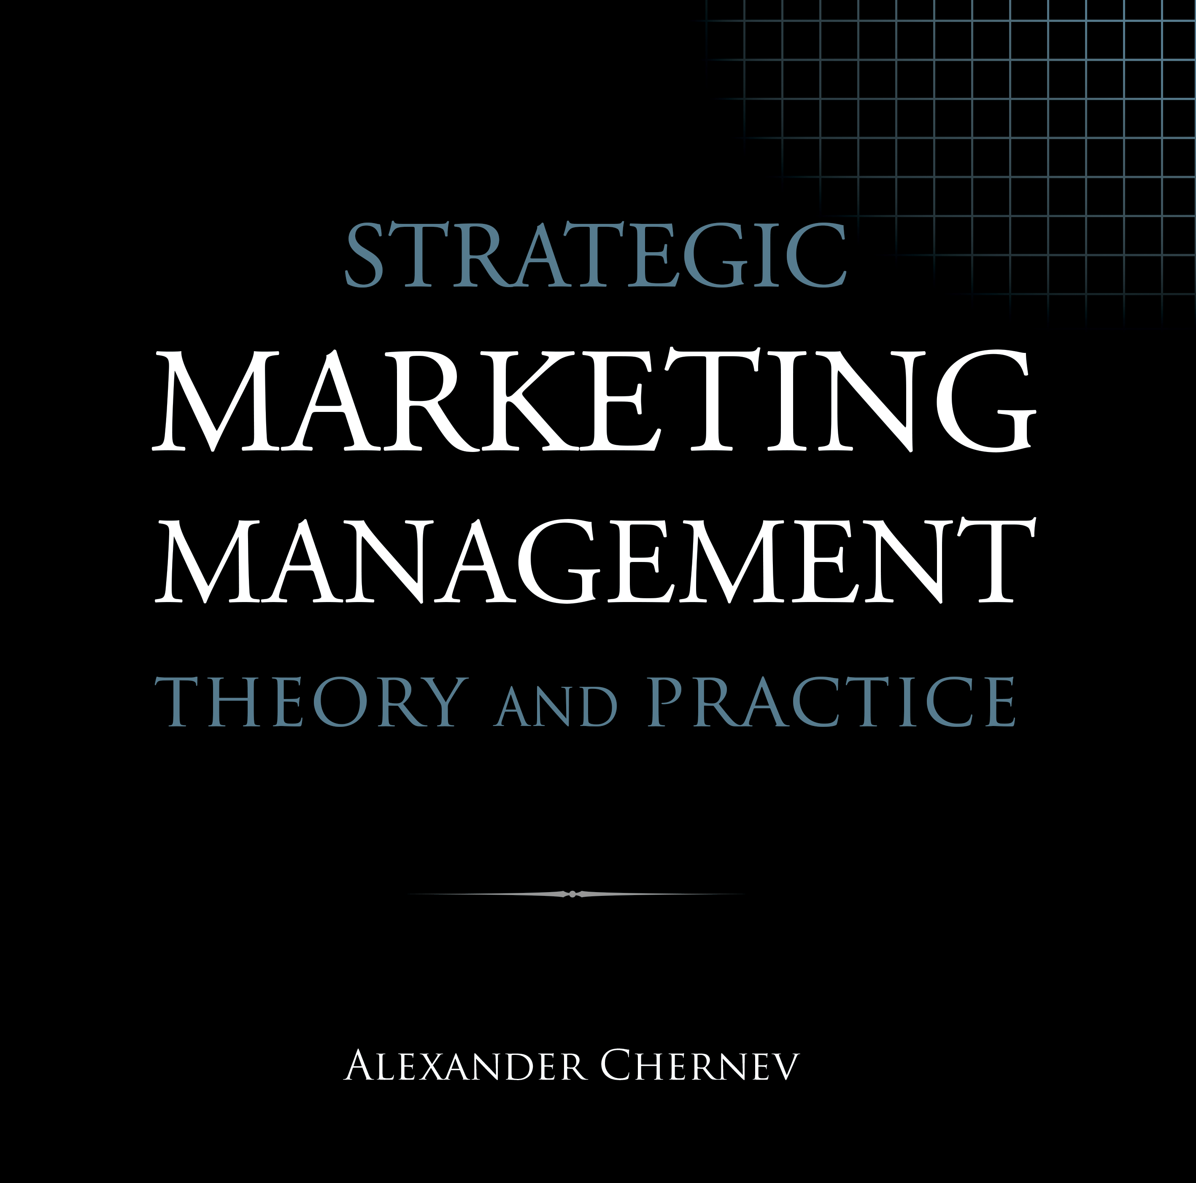

Slide 2
Strategic Marketing Management | Theory and Practice
ISBN: 978-1-936572-58-8
January 2019
Copyright © 2019 by Alexander Chernev
Author website: Chernev.com
Supplemental materials: MarketingToolbox.com
Published by Cerebellum Press | Chicago, IL | USA

Slide 3
Part VII: Marketing Toolbox

Slide 4
Appendix A
Segmentation and Targeting Workbook

Slide 5
Figure 1. Identifying Target Customers
Define the key value drivers
Segment the market
Strategic targeting
Assess segment attractiveness
Assess segment compatibility
Select strategically viable segment(s)
Tactical targeting
Define the segment profile
Assess tactical viability of segment(s)
Select target segment(s)

Slide 6
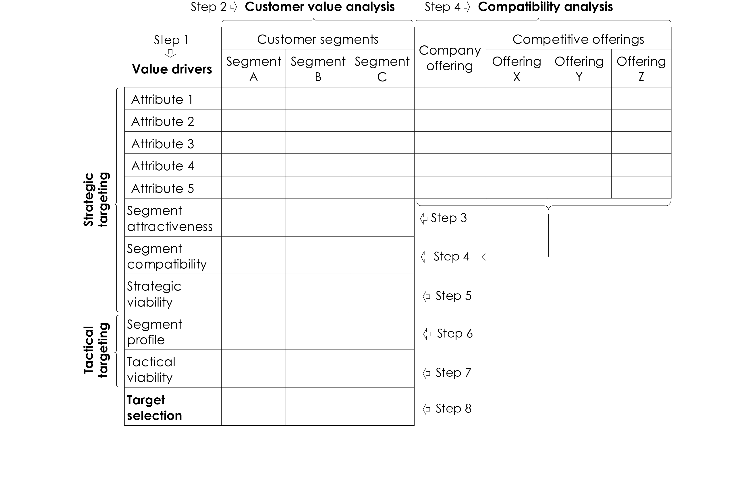
Figure 2. The Targeting Matrix

Slide 7
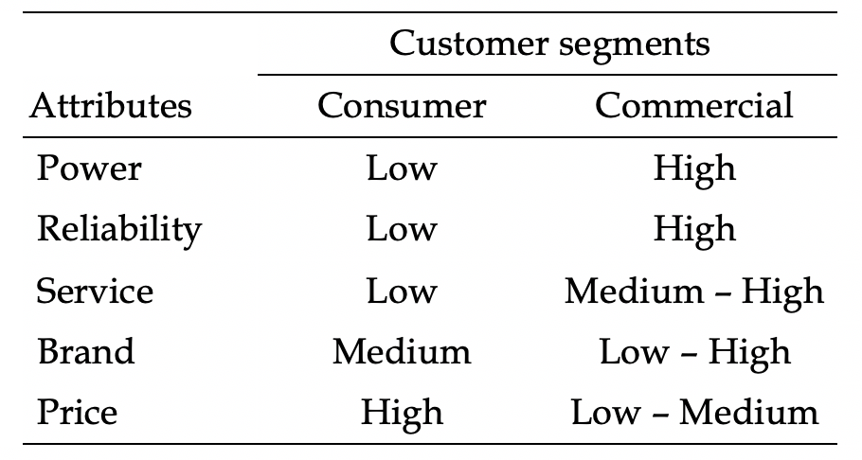
Figure 3. Customer Value Analysis Workbook (Two Segments)

Slide 8
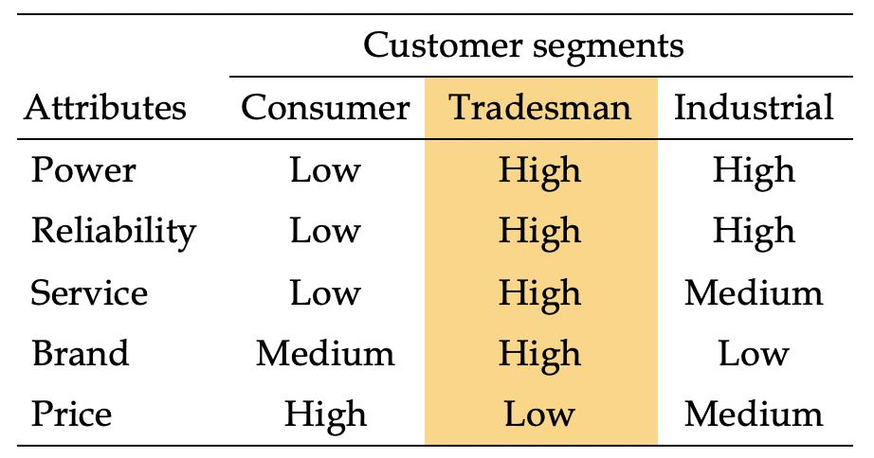
Figure 4. Customer Value Analysis Workbook (Three Segments)

Slide 9
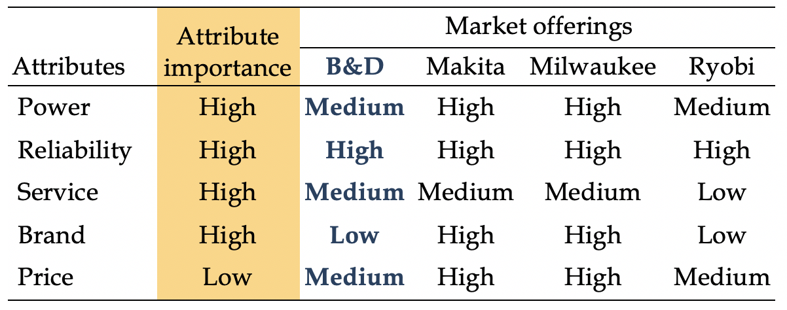
Figure 5. Compatibility Analysis Workbook (Tradesman Segment)

Slide 10
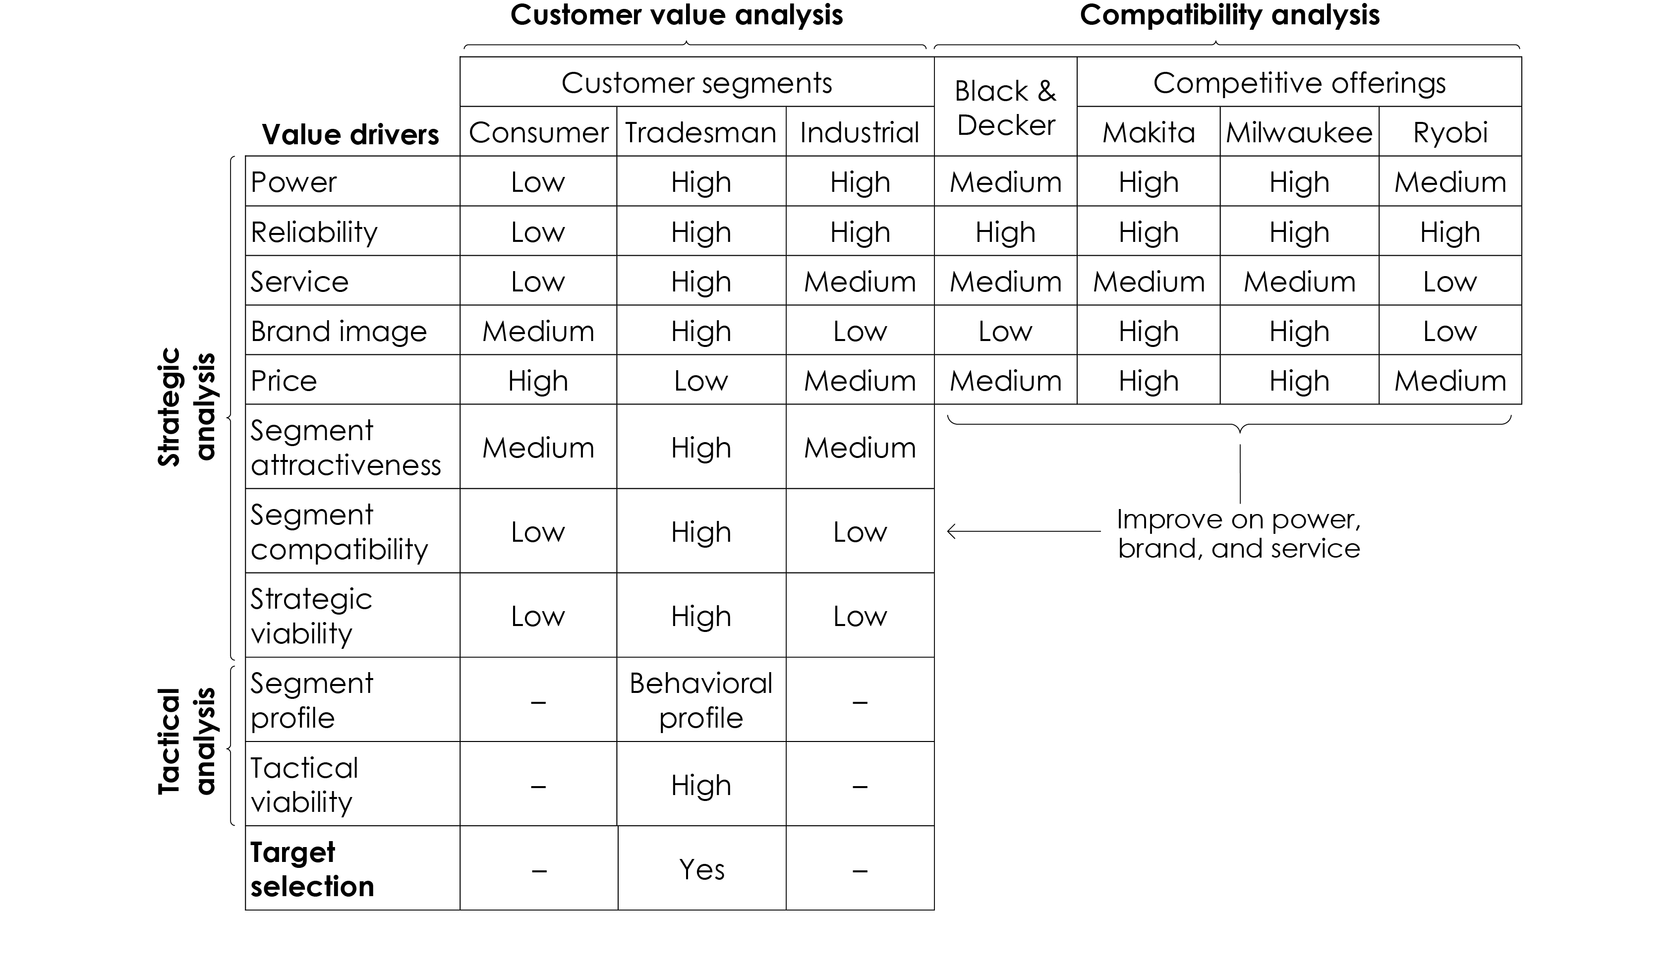
Figure 6. The Targeting Matrix: Black & Decker

Slide 11
Appendix B
The Business Model Workbook

Slide 12
Figure 1. The Market Value Map
Target Market
Market Offering
Customers
Product
What customer need does the company aim to fulfill? Who are the customers with this need?
What are the key features of the company’s product?
Collaborators
What other entities will work with the company to fulfill the identified customer need?
Service
What are the key features of the company’s service?
Company
What are the company’s resources that will enable it to fulfill the identified customer need?
Brand
Competition
What are the key features of the offering’s brand?
What other offerings aim to fulfill the same need of the same target customers?
Price
Context
What is the offering’s price?
What are the sociocultural, technological, regulatory, economic, and physical aspects of the environment?
Value Proposition
Incentives
Customer Value
What incentives does the offering provide?
What value does the offering create for target customers?
Communication
Collaborator Value
How will target customers and collaborators become aware of the company’s offering?
What value does
the offering create for the company’s collaborators?
Company Value
Distribution
What value does the offering create for the company?
How will the offering be delivered to target customers and collaborators?

Slide 13
Figure 2. The Customer Value Map
Target Customers
Customer Offering
Customer need
Product
What customer need does the company aim to fulfill?
What are the features of the product that the company offers to target customers?
Customer profile
Service
Who are the customers with this need?
What are the features of the service that the company offers to target customers?
Competition
Brand
Key competitors
What are the features of the offering’s brand?
What other offerings aim to fulfill the same customer need?
Price
What is the
offering’s price for target customers?
Value proposition
What value do these
offerings create for target customers?
Incentives
What incentives does
the offering provide
to target customers?
Offering attributes
What are the key
aspects of the competitive offerings?
Communication
How will target
customers become aware
of the company’s offering?
Customer Value
How will the offering be delivered to target customers?
Reason to choose
Distribution
What value does the offering create for target customers? Why would they choose this offering?

Slide 14
Figure 3. The Collaborator Value Map
Collaborators
Collaborator Offering
Collaborator profile
Product
Which entities will
partner with the company to create value for target customers?
What are the features of the product that the company offers to collaborators?
Collaborator goals
Service
What goals do collaborators pursue
by partnering with the company?
What are the features of the service that the company offers to collaborators?
Competition
Brand
Key competitors
What are the features of the offering’s brand?
What other offerings aim to fulfill the same collaborator goals?
Price
What is the
offering’s price for collaborators?
Value proposition
What value do these
offerings create for collaborators?
Incentives
What incentives does
the offering provide
to collaborators?
Offering attributes
What are the key
aspects of the competitive offerings?
Communication
How will collaborators become aware of the company’s offering?
Collaborator Value
How will the offering be delivered to collaborators?
Reason to choose
Distribution
What value does the offering create for collaborators? Why would they partner with the company?

Slide 15
Figure 4. The Company Value Map
Company
Company Offering
Company profile
Product
What entity is managing the offering? What are its key resources?
What are the features of the product that the company offers to target customers and collaborators?
Company goals
Service
What goal does the company aim to fulfill with this offering?
What are the features of the service that the company offers to target customers and collaborators?
Alternative Options
Brand
Key alternatives
What are the features of the offering’s brand?
What alternative options can fulfill the same company goal?
Price
What is the offering’s
price for target customers and collaborators ?
Value proposition
What value do these
options create for the company?
Incentives
What incentives does
the offering provide to target customers and collaborators?
Option attributes
What are the key
aspects of the alternative options?
Communication
How will target
customers and collaborators become aware of the company’s offering?
Company Value
How will the offering be delivered to target customers and collaborators?
Reason to choose
Distribution
What value does the offering create for target customers? Why would customers choose this offering?

